Slide 1



Content-based image retrieval
Supervised by : Dr. Moumita Roy
Instructor : Indrajit kalita
Ankit Kumar
Roll No. 1901032
ankit.k@iiitg.ac.in

Slide 2
Introduction
-> Content-based image retrieval (CBIR) is the application of computer vision to the “Image Retrieval problem”, that is, the problem of searching for digital image in large databases.
-> “Content-Based” means that the search will analyze the “actual-contents” of the image. The term ‘content’ in this context might refer colors, shapes , texture or any other information that can be derived form the image itself.
What is the meaning of Content-Based Image Retrieval (CBIR)?

Slide 3
Challenges
->Semantic Gap:
-The semantic gap is the Lack of coincidence between the information that one can extract from the visual data
-User defined semantic similarity ,but the database can only provide similarity by data processing .
-> Huge amount of objects to search among.

Slide 4
Problem definition
->Increasing use of digital images, particularly via the internet , by professionals of all kinds.
->Inadequacy of current technology in handling images.
->Increasing interest in how people perceive search for and use image.
Why Research Image Data?

Slide 5
Dataset
-> find the similar images from a large scale dataset against a query image. Generally, the similarity between the representative features of the query image and dataset images is used to rank the images for retrieval. Basically we download 1 million dataset of jpeg images and going to work on it.
->Feature Extraction:
->several popular image features:
colour-based (RGB histogram)
texture-based(gabor filter)
shape-based(daisy, edge histogram, HOG (histogram of gradient)
deep methods (VGG net, Residual net)
all features are modulized
Used
Dataset Descriptions

Slide 6
Content-Based Image Retrieval and Feature Extraction: A Comprehensive Review ( summary of accuracy based on different feature) Academic Editor: Marek Lefik
A novel method for content-based image retrieval to improve the effectiveness of the bag-of-words model using a support vector machine ( journal of Information Science 2019, Vol. 45(1) 117–135 The Author(s) 2018 Article reuse guidelines: sagepub.com/journals-permissions)
Related Work

Slide 7
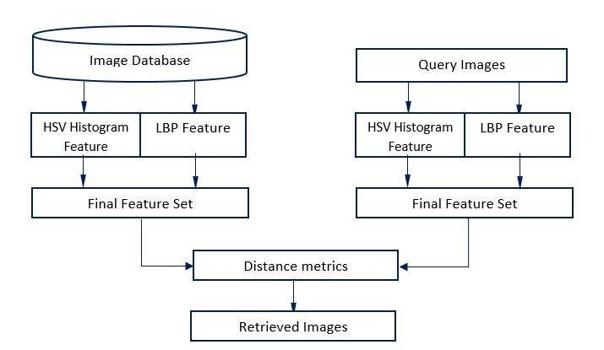
Methodology

Slide 8
Part1: Feature Extraction
Color-based
Texture-based
Shape –based
Deep-method
Feature Fusion:
Some features are not robust enough, and turn to feature fusion
Dimension Reduction:
The curse of dimensionality told that vectors in high dimension will sometimes lose distance property
Part2: Evaluation
CBIR system retrieves images based on feature similarity
Robustness of system is evaluated by MMAP (mean MAP)
Part3: Image Retrieval
Let me show some results of the system
Probable Steps to do:

Slide 9
1.
->Search for one specific image.
->General browsing to make an interactive choice.
->Search for a picture to go with a broad story or search to illustrate a document.
2.
->We don’t have yet a universally acceptable algorithm means of characterizing human vision, more specifically in the context of image understanding.
3.
->CBIR is used to search a specific image from a large dataset.
->CBIR makes interactive search of images from the databases.
->At present a Big MNC Giant company implemented this method named GOOGLE.
Results:
1.Applications
2.Limitations
3.Conculsion

Slide 10
Thank you
Work going on………..

